Slide 1

The Ethel project
An FTP application
Ali Yassin
Mohamed Amr
Ahmed Ramadan

Slide 2
Table of content
-What is FTP
-Goals of the project
-Features of the project:
-FTP server
-FTP Client
-Easy file transfer

Slide 3
What is FTP?
File transfer protocol

Slide 4


Take this image
Client Ali
Server
Client Ahmed

Slide 5
How it works
Client Ali
Sure!
Server
Client Ahmed

Slide 6
How it works
Client Ali
Give me the picture
Server
Client Ahmed

Slide 7

How it works
You don’t have access to Ali’s
picture
Client Ali
Server
Client Ahmed

Slide 8
Main Goals of the project
-Streamline the process of starting FTP servers
-Easily share files across the internet
-Maximize security of the server data
-Offer flexible options to navigate the server

Slide 9
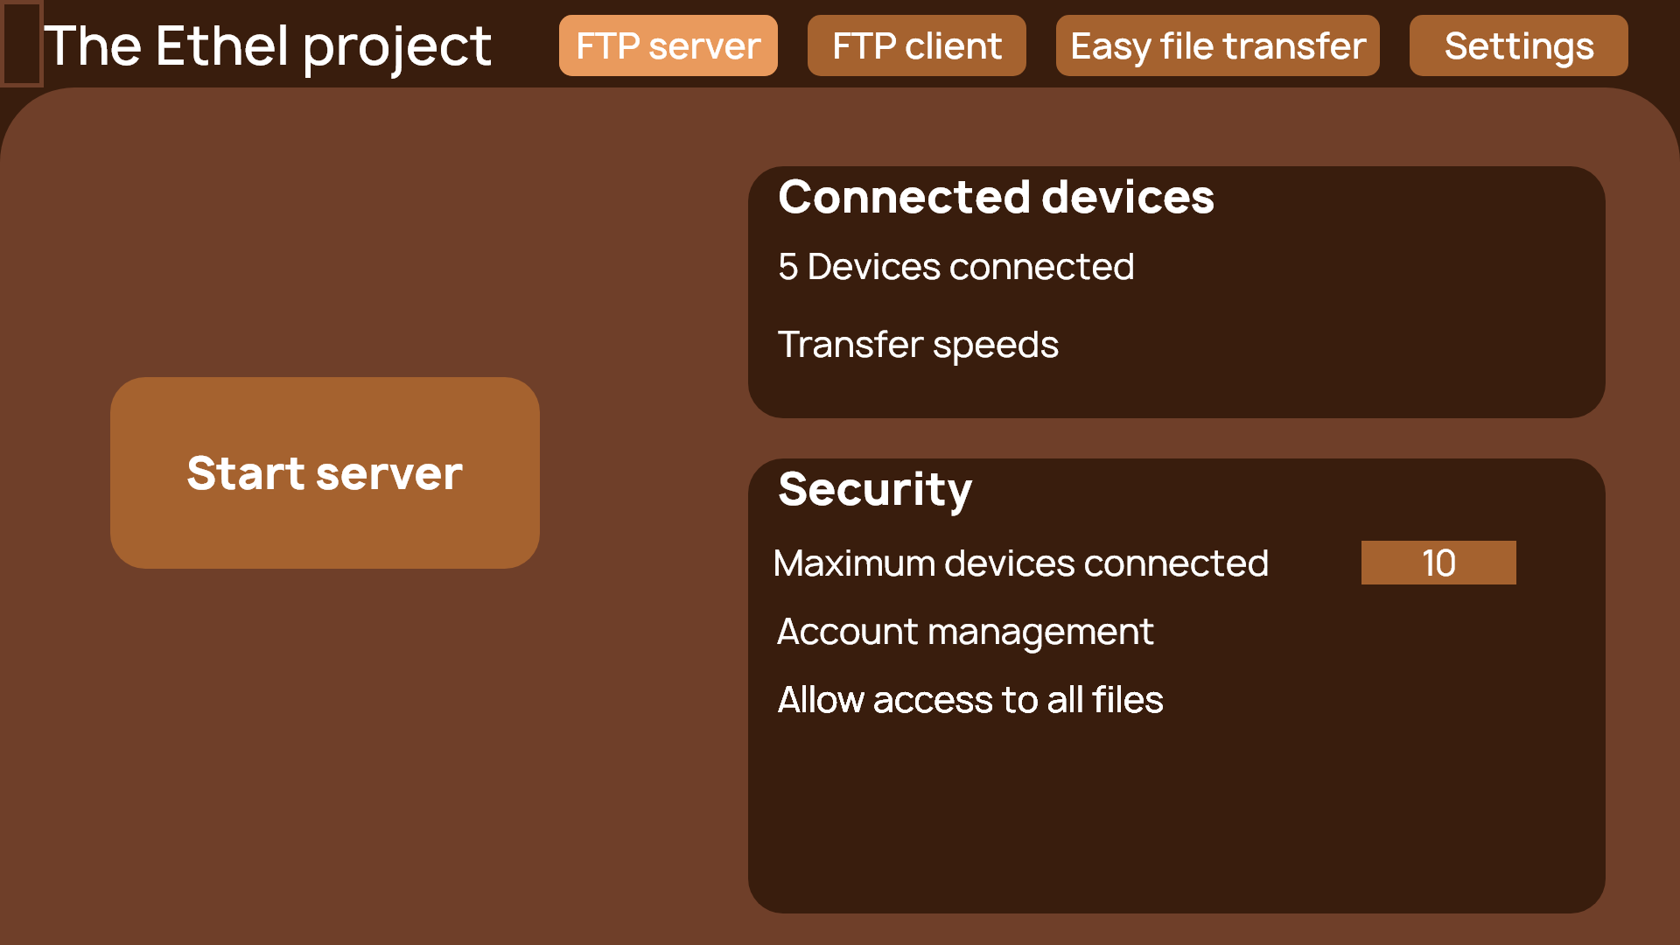
Make FTP
server
-Account system
-Server tracking
-

Slide 10
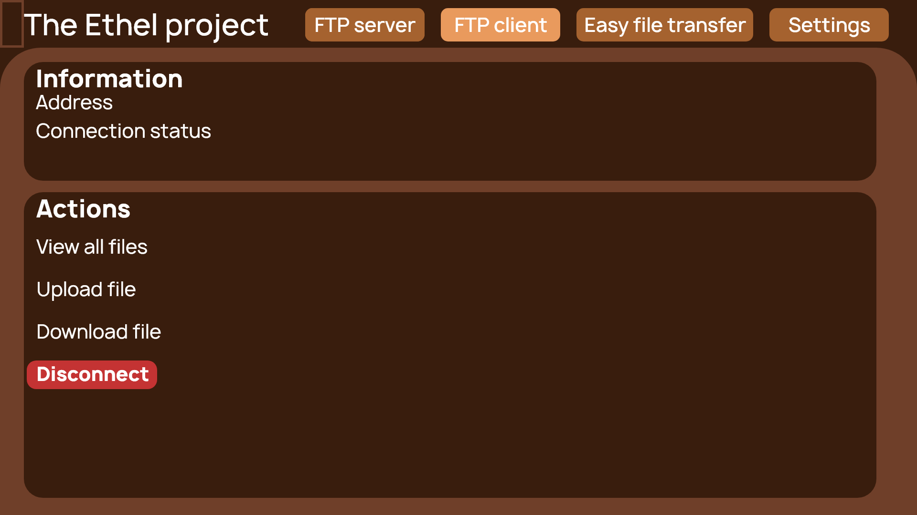
Client connection
-Access files on server
-File management
-

Slide 11
Easy
File transfer

Slide 12

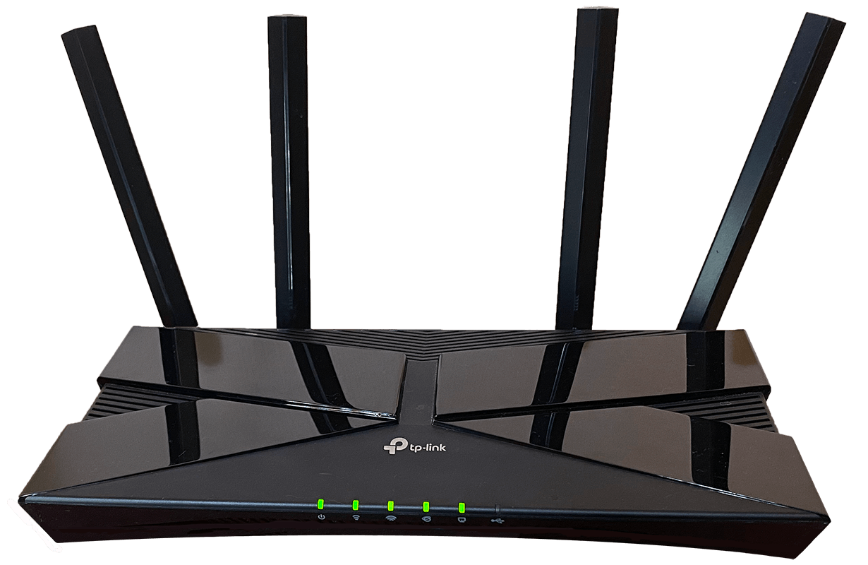
Ali’s computer
Mohamed’s computer
Home wifi
How it works
Ahmed’s computer

Slide 13
Give this folder to Ahmed
Ali’s computer
Mohamed’s computer
Home wifi
How it works
Ahmed’s computer

Slide 14
Ali’s computer
Mohamed’s computer
Home wifi
How it works
Ahmed’s computer

Slide 15
Ali’s computer
Mohamed’s computer
Home wifi
Thanks!
How it works
Ahmed’s computer

Slide 16
Easy
File transfer
Easy transfer screenshot
-Quick process
-Just select file and target location
-

